Slide 1
Employee Data Analysis Using Excel STUDENT NAME: KIRTHIKA B REGISTER: 312217935 NM ID: 4CC64838EBD7B75BB20430FA6C88C24A DEPARTMENT: B.COM ACCOUNTING AND FINANCE COLLEGE: St. Anne’s Arts And Science College, Chennai

Slide 2

EMPLOYEE DATA ANALYSIS USING EXCEL
PROJECT TITLE

Slide 3
agenda
1. Problem Statement
2. Project overview
3. End users
4. Our solution and Proposition
5. Dataset Description
6. Modelling Approach
7. Results and discussion
8. Conclusion

Slide 4

PROBLEM STATEMENT
This project aims to analyze employee performance based on satisfaction levels using Excel. The goal is to identify patterns and correlations within the data to help improve employee satisfaction and performance across different demographics and business units.

Slide 5
PROJECT OVERVIEW
The "Employee Performance Analysis Using Excel" project focuses on evaluating employee performance by analyzing key factors such as satisfaction levels, gender, and business unit. The project involves collecting and organizing employee data in Excel, followed by detailed analysis using statistical functions and data visualization tools. By identifying trends and correlations, the analysis will provide insights into how different factors impact performance across various demographics and departments. The findings will support data-driven decision-making to enhance employee satisfaction and optimize performance within the organization.

Slide 6




HR MANAGER
DEPARTMENT MANAGER
DATA ANALYST
EXECUTIVES

Slide 7
OUR SOLUTION AND ITS PROPOSITION
CONDITIONAL FORMATING | FILTER | FORMULA | PIVOT TABLE | SLICER | GRAPH
HIGHLATING CELLS THAT ARE BLANKS OR HAVE NO VALUE | FOCUSING ON BLANK CELLS AND REMOVING THEM | FOR IDENTIFYING EMPLOYEE PERFORMANCE | SUMMAFRIZING DATA AND ANALYSING RELATIONSHIP AND GENERATING REPORT | FILTERING DATA FOR ENHANCING USER EXPERIENCE AND HIGHLIGHT CLEAR VEIW OF SPECIFIC DATA | FOR DATA VISUALIZATION

Slide 8
DATASET DESCRIPTION
Dataset Name: Employee Performance Analysis Data
Description: Contains performance metrics for employees, including satisfaction scores, performance ratings, and demographic details
.Source: Kaggle.com
Variables/Columns:
Name: First name
Gender: Male and Female
Business Unit: BPC, CCDR, EW, MSC, NEL, PL, PYZ, SVG, TNS, WBL
Employee Type: contract, Full time, Part time Performance
Rating: Very high, High, Medium, Low Satisfaction
Score: 1-5 Data
Types: Numeric and Text
Units of Measurement : Satisfaction
score: Scale of 1-5
Performance rating: Very high, High, Medium, Low
Size: 26 records, 5 fields

Slide 9

THE "WOW" IN OUR SOLUTION
FORMULA
=IFS(Z2>=5,"VERY HIGH", Z2>=4,"HIGH",Z2>=3,"MEDIUM",Z2<=2,"LOW")

Slide 10

MODELLING AND APPROACH
DATA COLLECTION
DATA SOURCES: EDUNET FOUNDATION DASHBOARD
BASIS: EMPLOYEE DATASET
DATA PREPARATION
FEATURE : FIRST NAME, DEPARTMENT, GENDER CODE, PERFORMANCE LEVEL, EMPLOYEE TYPE.
FEATURE SELECTION; SELECTION BASED ON PERFORMANCE.
DATA CLEANING
CONDITIONAL FORMATTING: MISSING VALUES WAS IDENTIFIED.

Slide 11
MODELLING AND APPROACH
DATA AGGREGATION
EXCEL FUNCTION: IFS FUNCTION USED FOR CATEGORIZING EMPLOYEES ON THE BASIS OF THEIR PERFORMANCE LEVEL.
PERFORMANCE LEVEL CATEGORIES
5 – VERY HIGH
4 – HIGH
3 – MEDIUM
2&1 - LOW

Slide 12
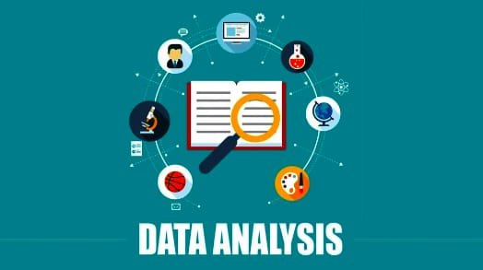
MODELLING AND APPROACH
DATA ANALYSIS
PIVOT TABLE: PIVOT TABLE WAS GENERATED TO SUMMARIZE DATA AND CROSS TABULATION(PERFORMANCE LEVEL BY DEPARTMENT;FILTERED BY GENDER)
SLICER: TO FILTER/SLICE THE DATA TO SCRUTINIZE AND SORT PARTICULAR INFORMATION(EMPLOYEE TYPE)
VISUALIZATION OF DATA
CHART: RECOMMENDED CHARTS(COLUMN CHART) WAS USED
CHART ELEMENT: CHART TITLE WAS ADDED
TRENDLINE: LINEAR AND EXPONENTIAL LINE WAS USED

Slide 13
RESULT

Slide 14
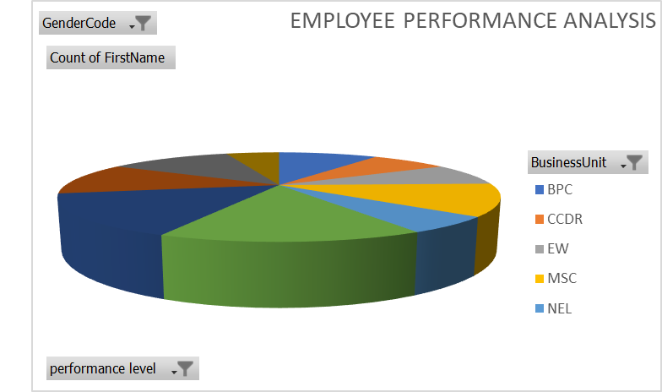


Slide 15
CONCLUSION
THIS PROJECT FOCUSES ON EMPLOYEE PERFORMANCE ANALYSIS CONDUCTED USING EXCEL, IT IS EVIDENT THAT KEY PERFORMANCE INDICATORS SUCH AS PRODUCTIVITY,EFFICIENCY PLAY A CRUCIAL ROLE IN OVERALL PERFORMANCE. THE ANALYSIS HIGHLIGHTS TOP-PERFORMING EMPLOYEES AND AREAS NEEDING IMPROVEMENT. RECOMMENDATIONS INCLUDE TARGETED TRAINING AND BETTER RESOURCE ALLOCATION. THIS APPROACH CAN HELP ENHANCE EMPLOYEE PERFORMANCE AND ACHIEVE ORGANIZATIONAL GOALS MORE EFFECTIVELY.

